Slide 1
Assignment 1 Case Study
Continental Airlines Fly high with Real Time Business Intelligence.

Slide 2
Overview
Continental Airlines found in 1934 took a leap from –
“Worst to First” that shook the country
Reinvent with raising the Bar from “First to Favourite”
Airline in Trouble
Information Wasn’t Available
lacked the corporate data infrastructure
Reason for success –
Built in-house real time Data warehousing & Business Intelligence(BI) Tools
Aggressive Go Forward Plan helped to achieve business excellence
A re-energized workforce
Synergies between decision support and operations
changed business processes that utilize real-time data.
USA’s fifth largest airline and the seventh largest in the world

Slide 3
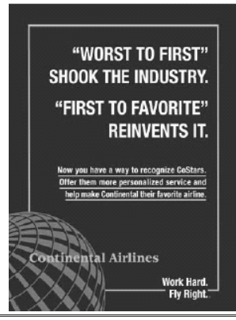
Key Concept - How Continental moved to Real Time BI application?
In 1994, Gordon Bethune presented a Go Forward plan having 4 interrelated parts-
Fly to Win
Fund the Future
Make Reliability a Reality
Working Together
Development of an enterprise data warehouse.
Make Reliability a Reality
Working Together - Continental Airline Internal Communications Poster
Three Initial Datawarehouse application
Demand-driven Dispatch
Goodwill Letters
Group snoop

Slide 4
Using Enterprise-DW + Decision Support System
REAL-TIME BI APPLICATIONS
Fare Design
Recovering Lost Airline Reservations
Customer Value Analysis
Marketing Insight
Flight Management Dashboard
Fraud Investigations
Is it Safe to Fly

Slide 5
SUPPORTING FIRST TO FAVORITE WITH TECHNOLOGY
The Data Warehouse
Data Access
Real-time Data Sources
The Data Warehouse Team
Data Warehouse Governance
Securing Funding
Examples –
Concourse Display of High-Value Customer Activity
Display of Flight Lateness From/To Hubs

Slide 6
Benefits from Real-time BI and inhouse Data Warehousing
Marketing
Corporate Security
IT
Revenue Management

Slide 7
The Go Forward Plan
Fly to Win. Continental needed to better understand what products customers wanted and were willing to pay for.
Fund the Future. It needed to change its costs and cash flow so that the airline could continue to operate.
Make Reliability a Reality. It had to be an airline that got its customers to their destinations safely, on-time, and with their luggage.
Working Together. Continental needed to create a culture where people wanted to come to work.

Slide 8

The Data Warehouse
A data warehouse is a huge collection of corporate data that is used to aid an organization's decision-making.
Continental’s real-time BI initiative is built on the foundation of an 8-terabyte enterprise Teradata Warehouse running on a 3 GHz, 10-node NCR 5380 server.
The data warehouse supports 1,292 users who access 42 subject areas, 35 data marts, and 29 applications.
Critical information derived from data warehouse analysis (for example, customer value) is sent back into operational systems.

Slide 9
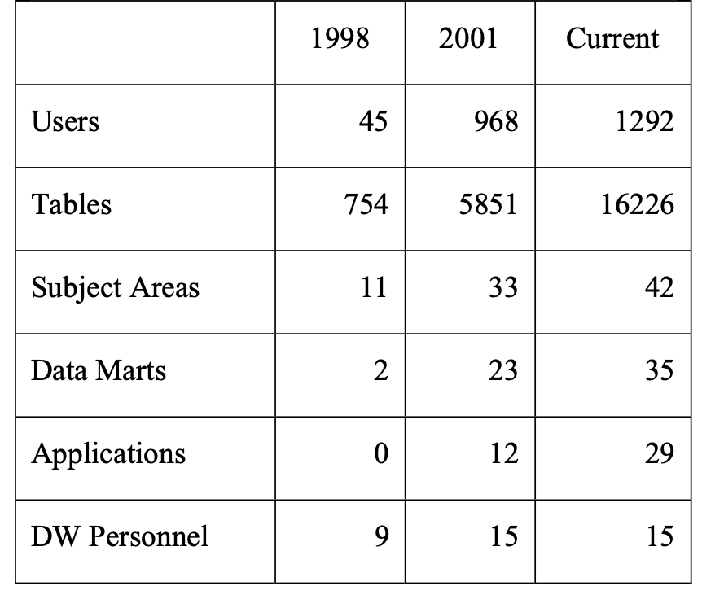
The growth of warehouse over time
THE GROWTH OF WAREHOUSE OVER TIME

Slide 10
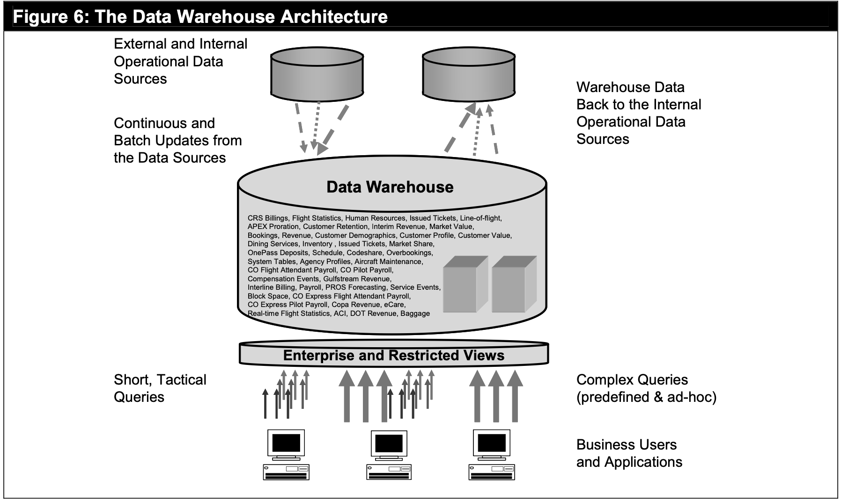
Data Warehouse Architecture
Data Warehouse Architecture

Slide 11
Data Warehouse Architecture
The basic architecture of the data warehouse is shown in the figure above, Data from 25 internal operational systems (e.g., the reservations system) and two external data sources (e.g., standard airport codes) are loaded into the data warehouse.
Some of these sources are loaded in real-time and others in batch, based on the capabilities of the source and the business need
Other data sources are pushed real-time by the sources themselves, triggered by events.

Slide 12
Data Warehouse Governance:
This is a 30 strong group from different business areas, who are responsible for
Educating the warehouse team with aspects of their respective business areas
Providing additional funds if needed.
Laying out a vision for future needs
Giving direction and guidance.

Slide 13
Benefits of Business Intelligence
Although the initial investment was around 30 million dollars to implement a BI system, the revenues that was recorded exceeded 500 million dollars.
It helped the company identify their most loyal customers and established a strong relation with the customers in times of need such as the attacks of 9/11.
All the redundant processes were identified and removed.
BI systems allowed continental airlines to explore different business models and revenues.
Benefits of Business Intelligence

Slide 14
Three Initial Datawarehouse Applications
Three Initial Datawarehouse Applications
Demand-driven Dispatch - After the data warehouse, Continental created Demand-driven Dispatch, an application that takes forecast information from the revenue management data mart (which is integrated with the enterprise data warehouse) and flight schedule data from the data warehouse, and identifies opportunities for maximizing aircraft usage. The application identifies opportunities to make short-term adjustments that do not disrupt operations
Good Will Letters - The marketing department pulled this data from the warehouse and divided a sample of these high-value Continental customers into three groups. When individuals were delayed more than 90 minutes, one group received a form letter apologizing, a second group received the letter and a trial membership to the President’s Club (or some other form of compensation), and a third group received no letter. Customers who received regular written communication spent 8 percent more in the next 12 months.
Group Snoop refers to a fare rule and contract compliance application that attempts to reduce the risk of flight “no shows.” Using booking and agency data from the warehouse, this application sorts by booking agent and travel agent and then queries all groups of less than ten and identifies the same travel agent ID and itinerary. Continental can then assess seat inventory more accurately and get travel agents to comply with group booking requirements. Group Snoop has provided an annualized savings of $2 million for Continental.

Slide 15
Lesson #1: Prepare Early for Real-Time BI Processes
Data Warehousing activities on their own only allow for the storage and retrieval of information
Manually updated data causes a bottleneck in actively using the data that grows exponentially longer the larger your business, and by extent database, gets.
Goal of businesses are to maximize profits, which requires growth and will eventually guarantee the bottleneck becomes unbearable
Real-Time Business Intelligence services will be required eventually in a business’ lifetime

Slide 16
Lesson #2: Some Data Should NOT be Real-Time
Data requires resources to store and sort, making it accessible and updated in real-time takes even more resources
Depending on the business, some data benefits greatly from being stored in real-time (Continental and itinerary of booked flights), but sometimes there can be no benefit from switching the data to real-time storage such as data that is rarely updated (quarterly earnings).
Making this type of data accessible and updated in real-time is redundant, and results in a loss of resources

Slide 17
Lesson #3: Business and IT Departments should be in Sync
Business decisions directly impact the management of data warehousing (funding, change in strategy), and the IT department plays a key role in Business operations (market analysis, performance evaluation, information for decision)
Strategic decisions made by corporate departments can have a heavy impact on IT operations, negative OR positive (Continental response priority)
IT Department can function in isolation, this can cause issues such as an internal conflict of interests and massively reduced resource efficiency within the department, and in turn the company as a whole

Slide 18
Lesson #4: Cross Understanding of Departments
Corporate workers tend to have difficulty understanding the IT world, and vice versa
Lack of understanding can lead to reduced efficiency, and even the complete halt of any productivity in extreme situations
Efforts should be made from both departments to make their work understandable to the other (Continental prototypes, graphs/charts, step-by-step business strategy plans)
By mixing the skill sets of the departments, there will be a massive boost of productivity and efficiency through the removal of confusion.

Slide 19
Lesson #5: Align Decision Making to Support Real-Time Data
There are three bottlenecks when it comes to acting on information: the time it takes to extract the data, the time to analyze the data, and the time to act on the data
A properly managed real-time database eliminates the first two bottlenecks; however you still need to act on the data
In order to properly capitalize on the efficiency of a real-time database, a business needs their decision-making process to be flexible and incorporate said information
.

Slide 20
Lessons in Action: Continental
Continental’s IT department prepared for the eventuality of requiring real-time data in advance during the development of their in-house data warehousing systems
They only make very specific data updated in real-time, and progressively added more over time in accordance with new strategies (Flight management dashboard, fraud detection)
IT department creates and showcases prototypes of what real-time data can do for the company and has consistent interactions with a committee of 30 high level corporate employees in order to sync business and IT interests (they also secure funding through a business partner rather than normal)
Corporate has implemented different priority levels for queries depending on how fast the information is needed.

Slide 21
Summary of Lessons
In short, real-time data management is an eventuality for most companies, so it is better to prepare for the conversion at the start then try to update it for a real-time data warehouse to be effective, the department managing it needs to work closely with higher level corporate employees in order to work towards a common goal. In addition, real-time updates to data should only be implemented when the data in question is, or will eventually be, of use in order to not waste resources.

Slide 22
THANK YOU

